Slide 1
SPACED OUT
Scale Models of the Nearby Universe

Slide 2
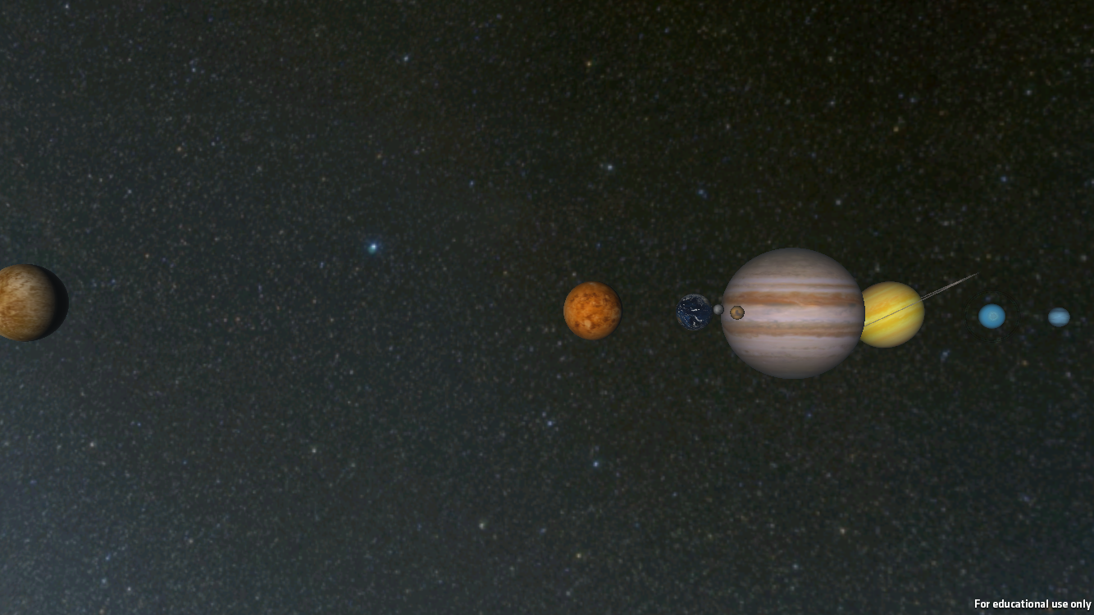
The solar system, as seen when you click on “Mercury”

Slide 3
Now do “Worlds In Comparison” activity

Slide 4
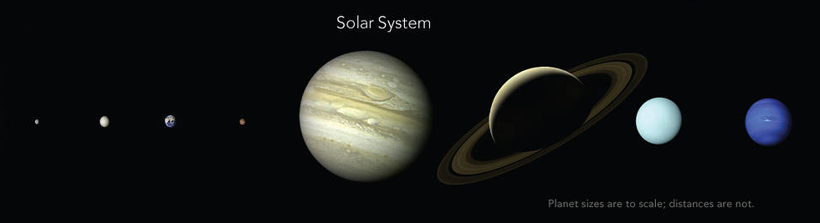
How the sizes REALLY compare
From: https://www.nasa.gov/image-feature/ames/kepler-90-system-planet-sizes
Notes:
Debrief the WORLDS IN COMPARISON activity by showing this slide.
The problem here is that while the size scale is correct, in order to fit them together on one screen, the distance scale is WAY too short (they are too close together).
How do we know the spacing of the planets? NOW DO THE Scale Model activity

Slide 5
But what about the SUN? How big is it? (Guess)
Smaller than Earth
About 2x as wide as Earth
About 10x as wide as Eartt
About 100x as wide as Earth
About 1000x as wide as Earth

Slide 6
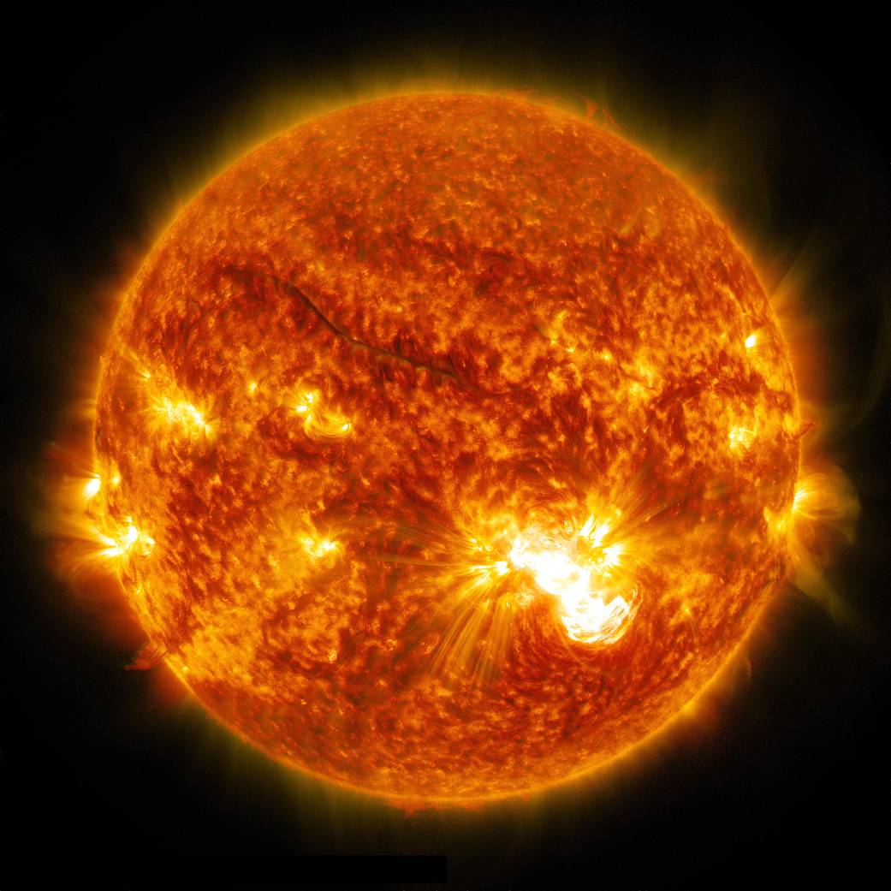
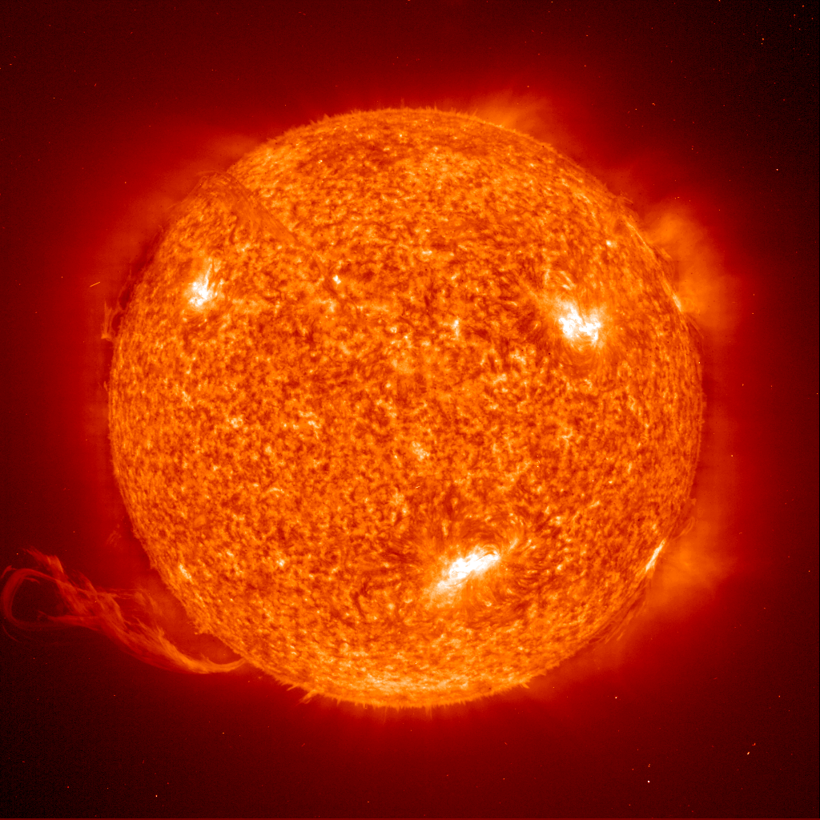
How close were you?
Diameter of the Sun
Image source: https://www.nasa.gov/content/goddard/sun-release-x3.1-class-solar-flare-on-oct-24-2014
Notes:
You can fit roughly 100 Earth’s across the Sun.

Slide 7
If you can fit 100 Earths ACROSS the Sun, how many could you fit INSIDE the Sun? (Hint: how is volume related to diameter?)
100
1,000
10,000
100,000
1,000,000

Slide 8
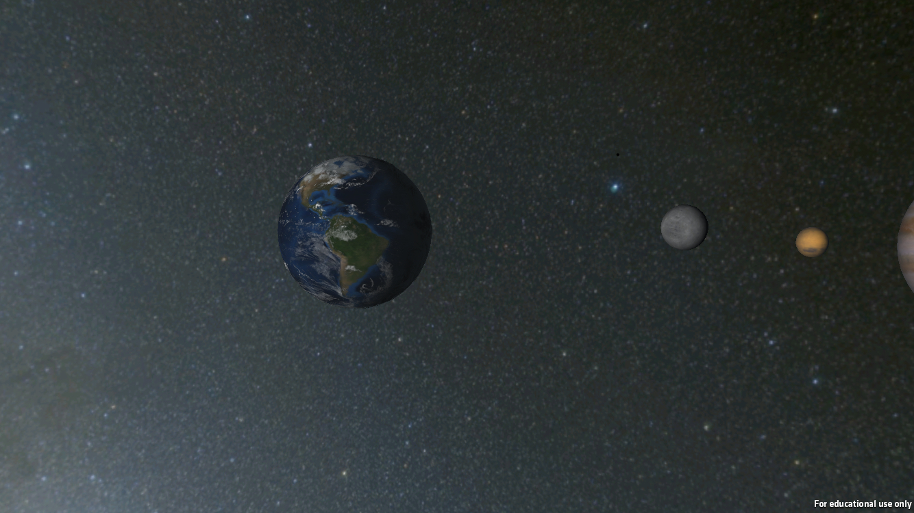
What about the SPACING? How closely do you think this models the Earth-Moon System?
Sizes are wrong and the distance is wrong
Sizes are right, but the distance is wrong
Sizes are wrong, but the distance is right
Sizes are right and the distance is right

Slide 9
PREDICT
Using the objects your instructor has given you, model the Earth-Moon system
The team closest to the correct answer gets a prize!

Slide 10
The Earth-Moon System
As seen in SCIVR:
To Scale
HOW CLOSE WERE YOU?
Notes:
You can fit roughly 30 Earth’s between the Earth and Moon.

Slide 11

Spacing of the Planets and the Pocket Solar System
10
20
30
40
50
40
30
20
10
Jupiter
Saturn
Kuiper Belt
Mercury
Uranus
Neptune
Earth
Asteroid Belt
Mars
Venus
10
20
30
40
50
40
30
20
10
Notes:
We can show them to the correct distance scale.
- Pocket Solar System activity
The trouble here is that, in order to see the planets, we have to make them way too big.

Slide 12
Notice how difficult it is to get both SIZE and DISTANCE scales represented simultaneously
(which is why nobody has a good instinct about them)

Slide 13
“A tediously accurate scale model of the solar system”
http://joshworth.com/dev/pixelspace/pixelspace_solarsystem.html

Slide 14
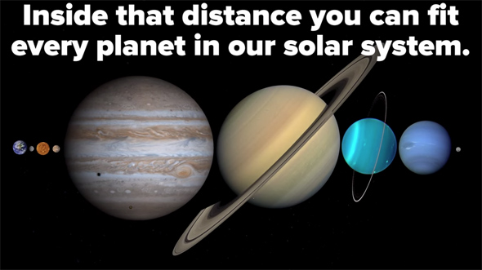
FUN FACT! It’s 384,000 km from Earth to the Moon, and…
Screenshot from BuzzFeedBlue’s video: https://www.youtube.com/watch?v=gIbfYsQfNWs

Slide 15
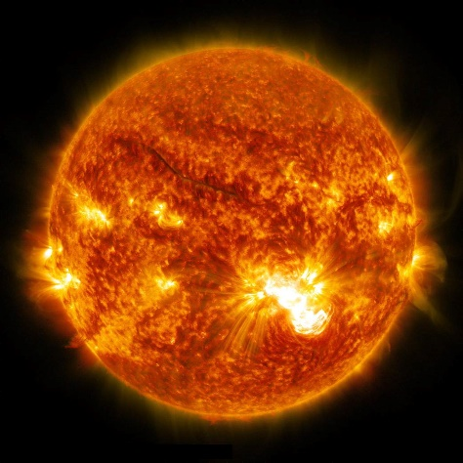

The Sun-Earth System
1 AU
Earth
Not To Scale
Notes:
You can fit around 100 Suns between the Sun and Earth.
How many Earth’s can you fit between the Sun and Earth? (100 x 100)

Slide 16
SCALE MODELS naturally result in units like the ASTRONOMICAL UNIT
  1 AU = The distance between Earth and the Sun.
  1 AU = 150,000,000 km.
1 AU

Slide 17
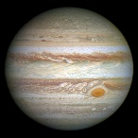
The planet Jupiter is about 5 AU from the Sun.
Or basically here:
(PSST: Sizes not to scale)

Slide 18
The planet Uranus is about 20 times as far from the Sun as Earth is. What statement is true?
Uranus is about 20 light years from the Sun
Uranus is about 20 million kilometers from the Sun
Uranus takes about 20 years to orbit the Sun.
Uranus is about 20 AU from the Sun.
Uranus is about 20 times the size of Earth.

Slide 19
But what’s an astronomical unit?
How do we know it’s 150,000,000 kilometers?

Slide 20
Time for
PART II of SPACED OUT SCALE MODELS

Slide 21
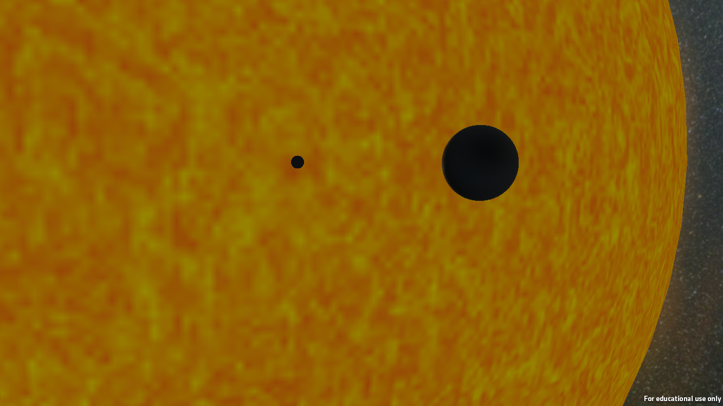
The view from “Earth” in the SCIVR solar system module. What are these objects?
(SCIVR screen grab)

